Slide 1



A digital publishing platform for Paleontology
https://osf.io/preprints/paleorxiv/
@paleorXiv

Slide 2
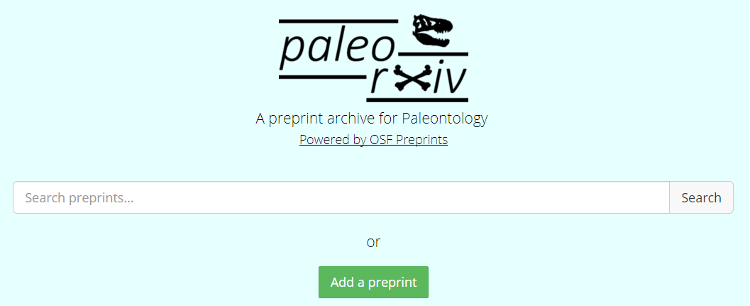
Welcome to paleorXiv!
@paleorXiv

Slide 3

Who are we?
@paleorXiv

Slide 4
What is a ‘preprint’ and a ‘preprint server’?
“In academic publishing, a preprint is a version of a scholarly or scientific paper that precedes publication in a peer-reviewed scholarly or scientific journal. The preprint may be available, often as a non-typeset version available free, before and/or after a paper is published in a journal.” (Wikipedia)
A preprint server is a platform to host such preprints.
Servers like paleorXiv also permit uploading of other content such as data, figures, code, and videos. Sort of like a ‘Dropbox for science’.
@paleorXiv

Slide 5
What is version control?
Version control allows content to be updated online as you make additions or changes to it.
For example, when an preprint has been peer reviewed, you can update the preprint with the new version, often called the postprint.
This allows authors to track the development of projects, and revert any changes if needed.
@paleorXiv

Slide 6
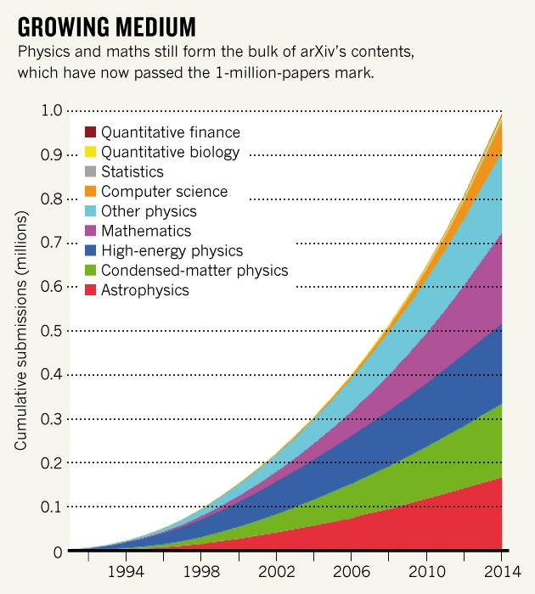
Are preprints new?
Nope. Preprints have been around for over 20 years, since the arXiv launched in 1991.
The arXiv, covering many topics including Physics, Maths, and Computer Sciences, currently hosts more than 1.3 million articles.
It is growing at around 8,000 submissions a month.
@paleorXiv

Slide 7
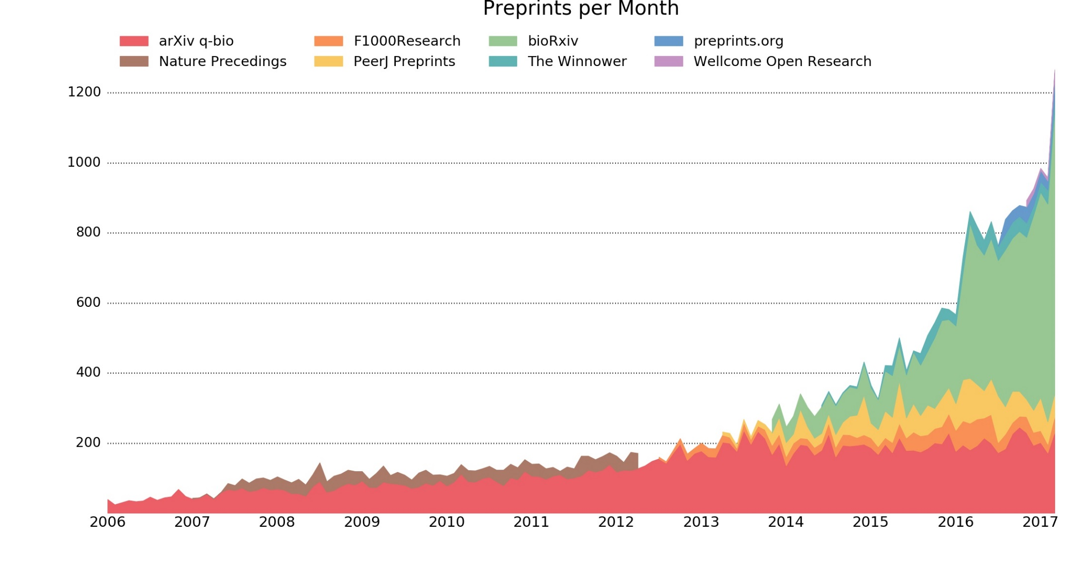
The growth of preprints
http://www.prepubmed.org/monthly_stats/
@paleorXiv

Slide 8

An explosion of new services
@paleorXiv

Slide 9
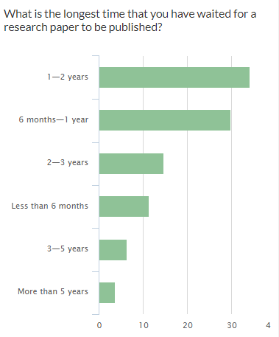
Why should you use paleorXiv?
It accelerates the publication process, which can be very slow at some journals.
Preprints speed up the dissemination, re-use, and citation of your research.
Preprints define the undeniable priority of your research by assigning a DOI and stamp of authority, thereby preventing ‘scooping’.
Preprints can be used to demonstrate ‘work in progress/press’ to your hiring and tenure committees, and granting agencies.
@paleorXiv

Slide 10
Why should I use preprints?
They are free to publish and access, and easy to submit.
You own the rights to your work through CC-BY licenses.
They are indexed by Google Scholar, and discoverable by tools such as Unpaywall and the OA Button.
Many major research funders now encourage preprint submissions in support of grant applications to aid authors in the process. E.g.:
German Science Foundation (DFG)
Wellcome Trust
National Institute of Health (NIH)
Cancer Research
@paleorXiv

Slide 11
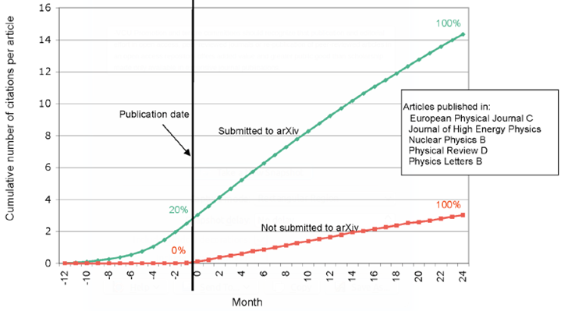
Preprints accelerate your citations
More
Faster
Earlier
http://whyopenresearch.org/
@paleorXiv

Slide 12
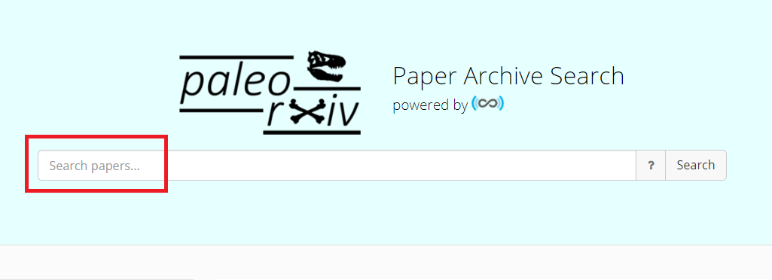
How to use paleorXiv
@paleorXiv

Slide 13
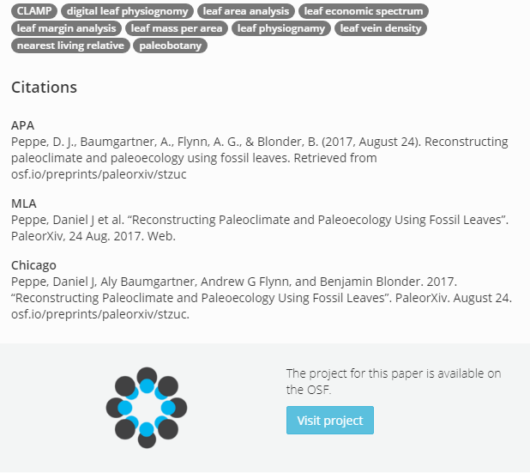
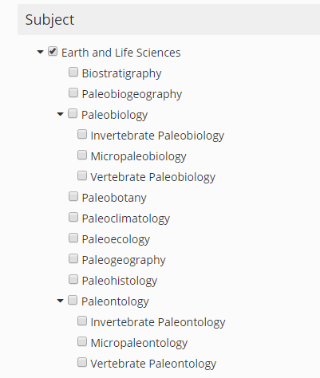
How to use paleorXiv
@paleorXiv

Slide 14
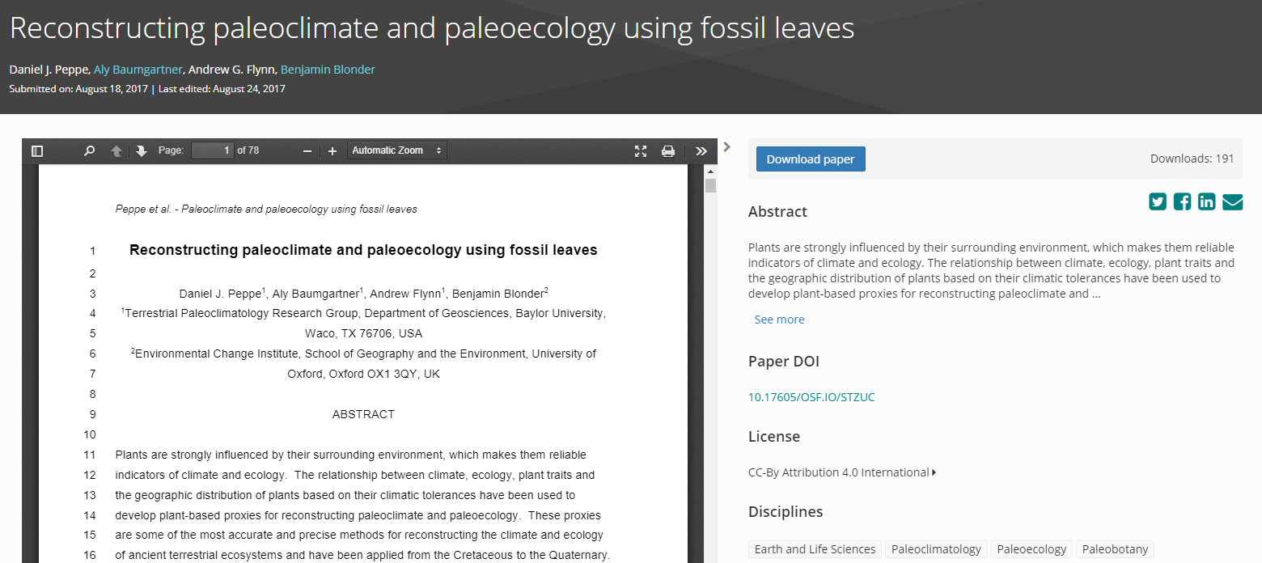
How to use paleorXiv

Slide 15
FAQ 1 – Why publish a paper if the work is already published as a preprint?
In the present reward system, journal publications influence funding and promotion decisions; the vast majority of research-paper preprints in physics are therefore also submitted to journals.
Journals provide additional services including:
Peer review
Increased visibility
Editorial control and standards
Branding and marketing
@paleorXiv

Slide 16
FAQ 2 - Will someone steal my work in my preprint?
Based on experiences at very established (e.g., ArXiv) and newer, but rapidly growing preprint services (e.g. BiorXiv, SocArXiv), there is no clear evidence that preprints lead to being scooped.
If someone is prepared to steal ideas from a timestamped/’DOI’d’ preprint, they would likely do the same from material in a journal or from a conference presentation.
The reputational damage associated with intellectual theft and plagiarism is significant and long-lasting; thus the latter is very rare.
@paleorXiv

Slide 17
FAQ 3 - Will preprints lead to large volumes of low-quality material on paleorXiv?
Anecdotal evidence suggests this behaviour has not emerged in the communities that use the arXiv.
Because preprinting requires public disclosure, authors are wary of developing a bad reputation. If the work is poor, it will likely be ignored by the rest of the community. The same applies to material published in any journal.
RSS feeds allow sorting of material in paleorXiv; cf. Google Scholar.
Initial evidence and download statistics suggests paleorXiv is hosting high-quality, desirable material.
@paleorXiv

Slide 18
FAQ 4 - Can paleorXiv host only preprints?
No. paleorXiv is also a repository for postprints (i.e. material already published in a journal).
Depending on journal policy, we can host the Author Accepted Manuscript (i.e. accepted version of paper, but before publisher typesetting) (AAMs) or the Version of Record (VoR) (i.e. published version of paper, after publisher typesetting).
Check your journal’s policy on self-archiving using paleorXiv’s database.
PaleorXiv can also host datasets, textbooks, book chapters, etc. Please contact us if you have any queries!
@paleorXiv

Slide 19
FAQ 5 - Will publishing a preprint mean I can’t publish in a journal?
In most cases, the answer is ‘no’.
Use of preprints has been ongoing in other disciplines for, in some cases, a few decades, many publishers have preprint-friendly policies already in place for their journals.
Again, please check your journal’s policy on our database here for more information.
Check before you submit - if you’re unsure, ask!
@paleorXiv

Slide 20
FAQ 6 - How do I link data to my preprint?
Open Science Framework’s infrastructure allows for an unlimited amount of space for direct uploading of publication-related data, but limited to 5GB per file.
More commonly, data, and especially large volumes of data, are stored on external sites (e.g. Dropbox, GitHub, figshare, Google Drive) and linked back to the related preprint/postprint.
More information on connecting these services via the OSF can be found here.
@paleorXiv

Slide 21
FAQ 7 - Does my preprint get a DOI and how might this impact citation count?
Preprints are minted with a DOI upon submission, which will persist even if the research is eventually published in a journal.
Preprints can collect citations, which count towards your h-Index.
Citations could, in theory, be split between preprints and the VoR.
The solution is to aggregate the citations through Google Scholar.
Preprints can direct readers to the published version (Version of Record or ‘VoR’) via a DOI; evidence indicates researchers typically cite the latter and not the former.
@paleorXiv

Slide 22
Further information
Submission guidelines for authors
Database of journal policies on Open Access and self-archiving
PaleorXiv’s Diversity Statement
PaleorXiv’s Code of Conduct
PaleorXiv on Twitter
Should we cite preprints?
ASAPbio Ambassadors
Funder policies (ASAPbio)
@paleorXiv

